Slide 1
PROPOSAL DEFENSE “Text-to-image Generation”
Neha Shrestha (24287 / 7th Semester / 2076)
Norden Ghising Tamang (24290 / 7th Semester / 2076)

Slide 2
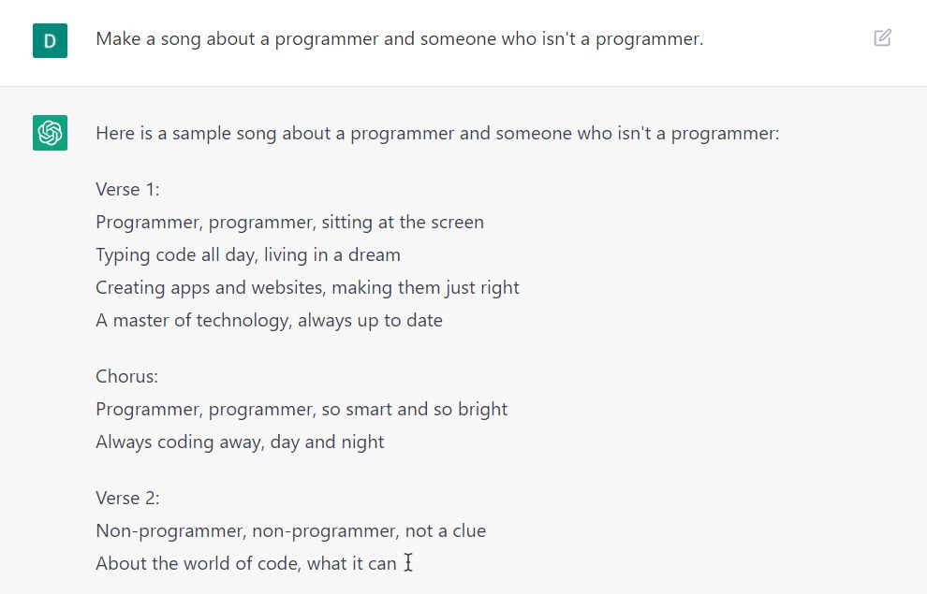
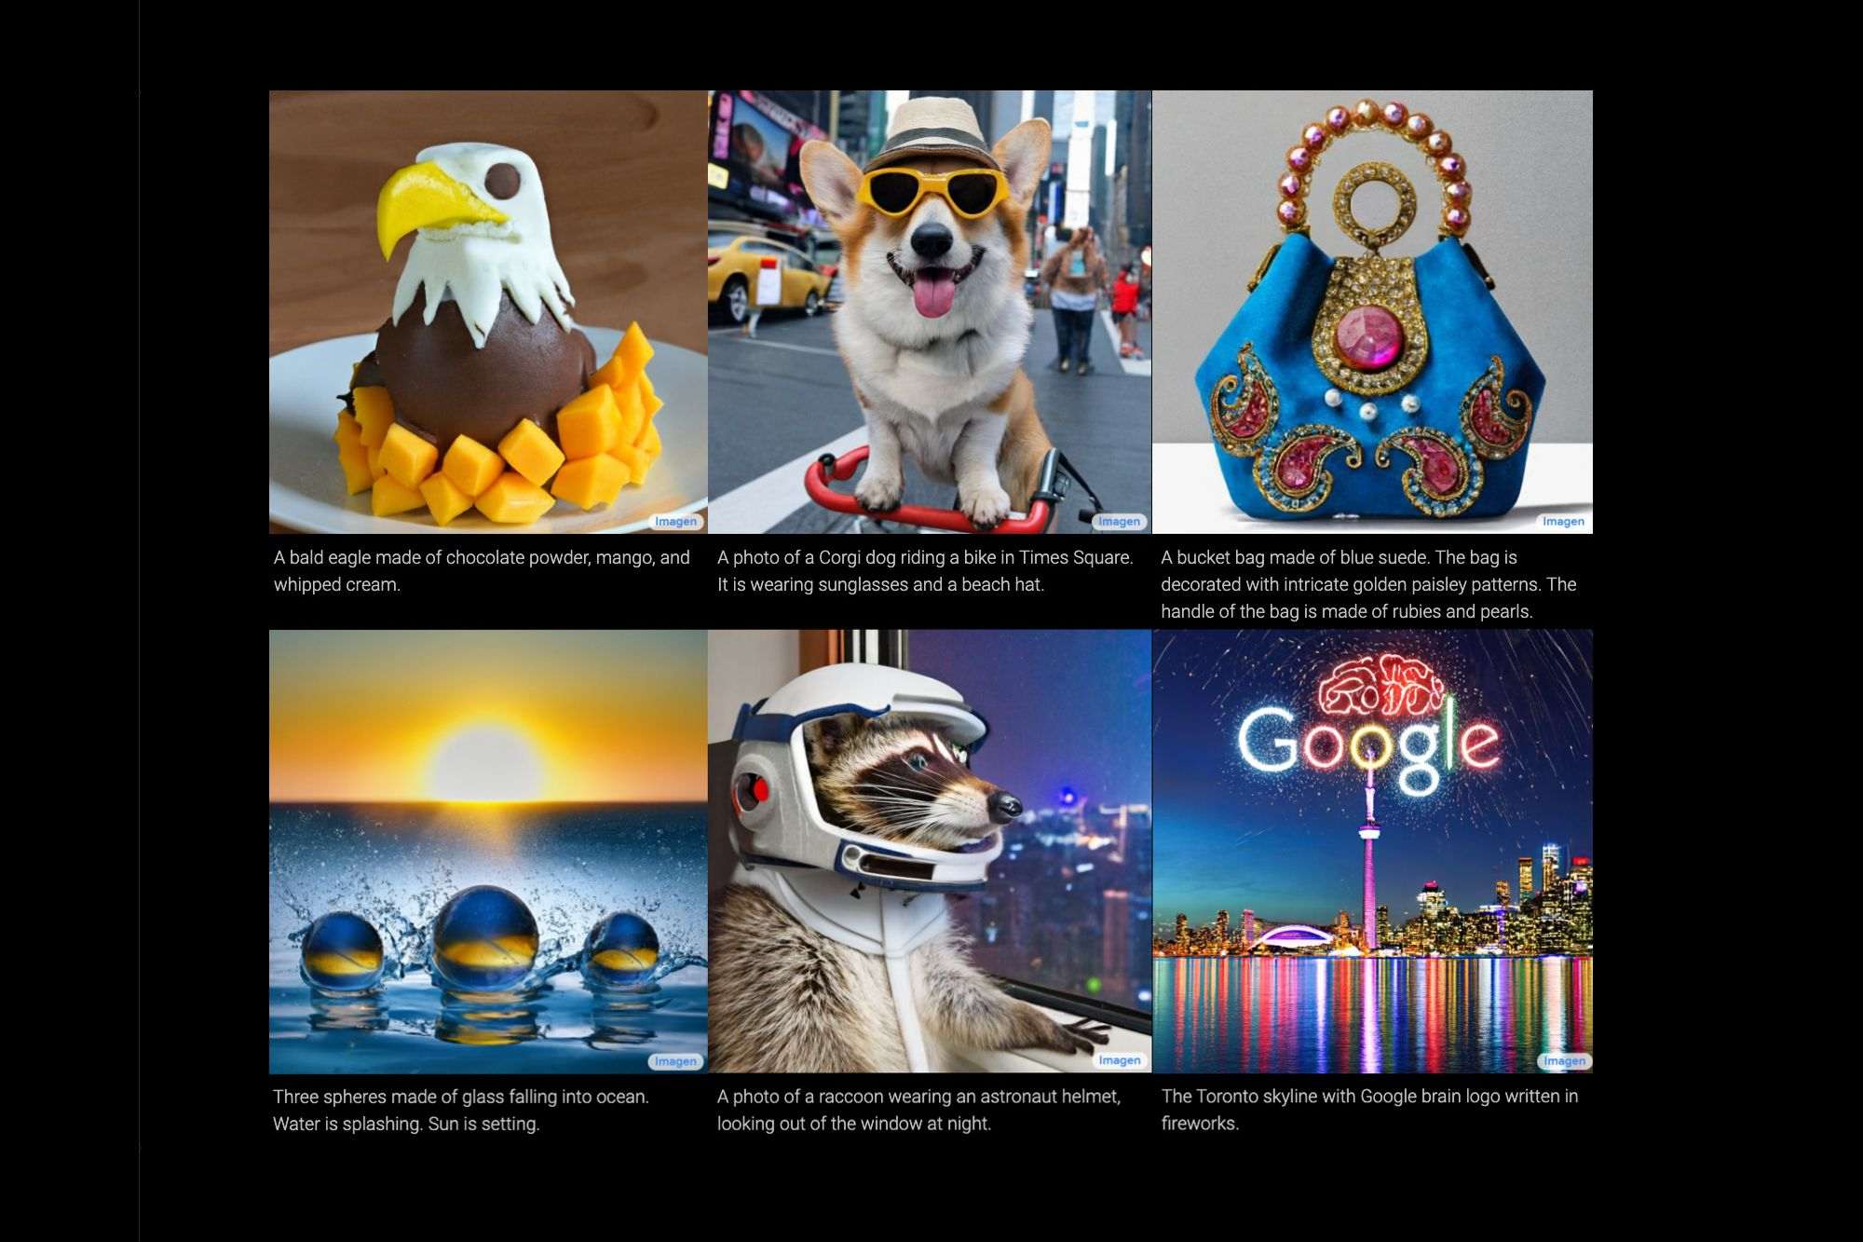
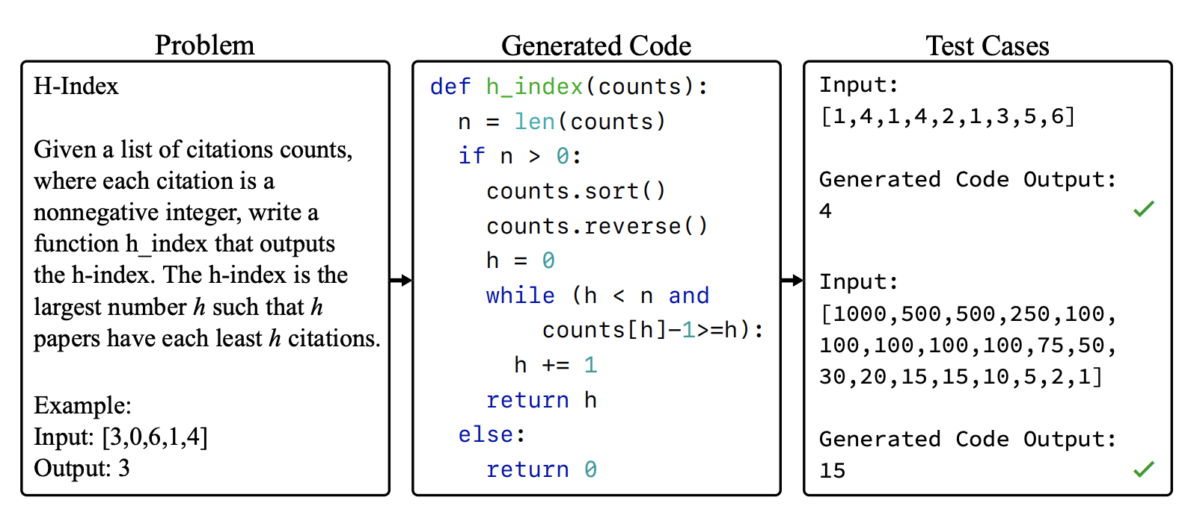
1. INTRODUCTION
Generative AI is subfield of AI
Generates new data such as images, texts, videos, audios, etc.
One example of Generative AI is Latent Diffusion
Latent Diffusion generate images given text prompts
Our text-to-image generation model is based on Latent Diffusion

Slide 3
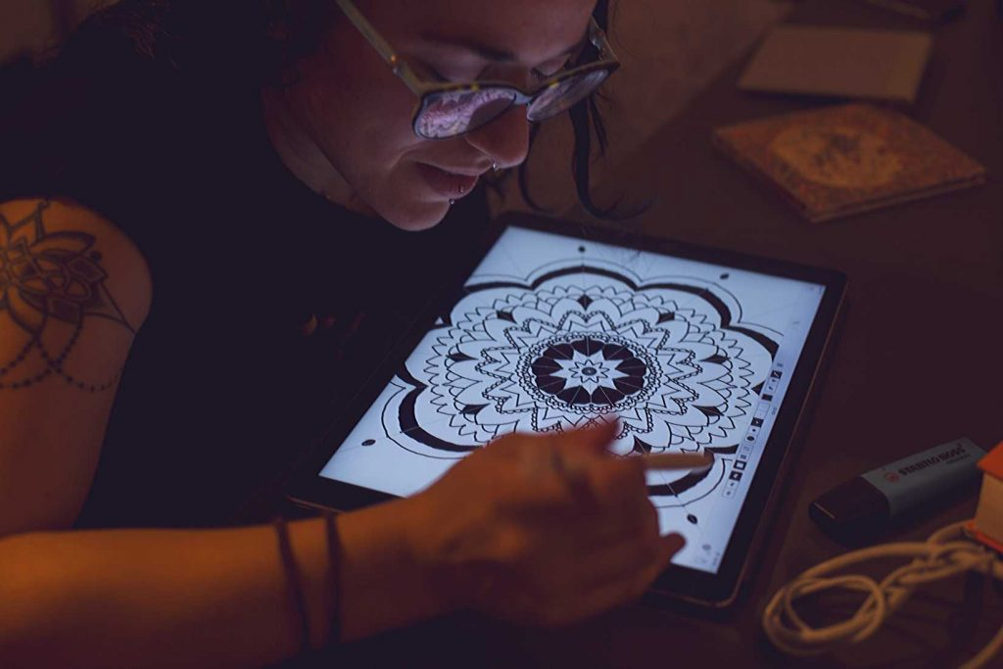
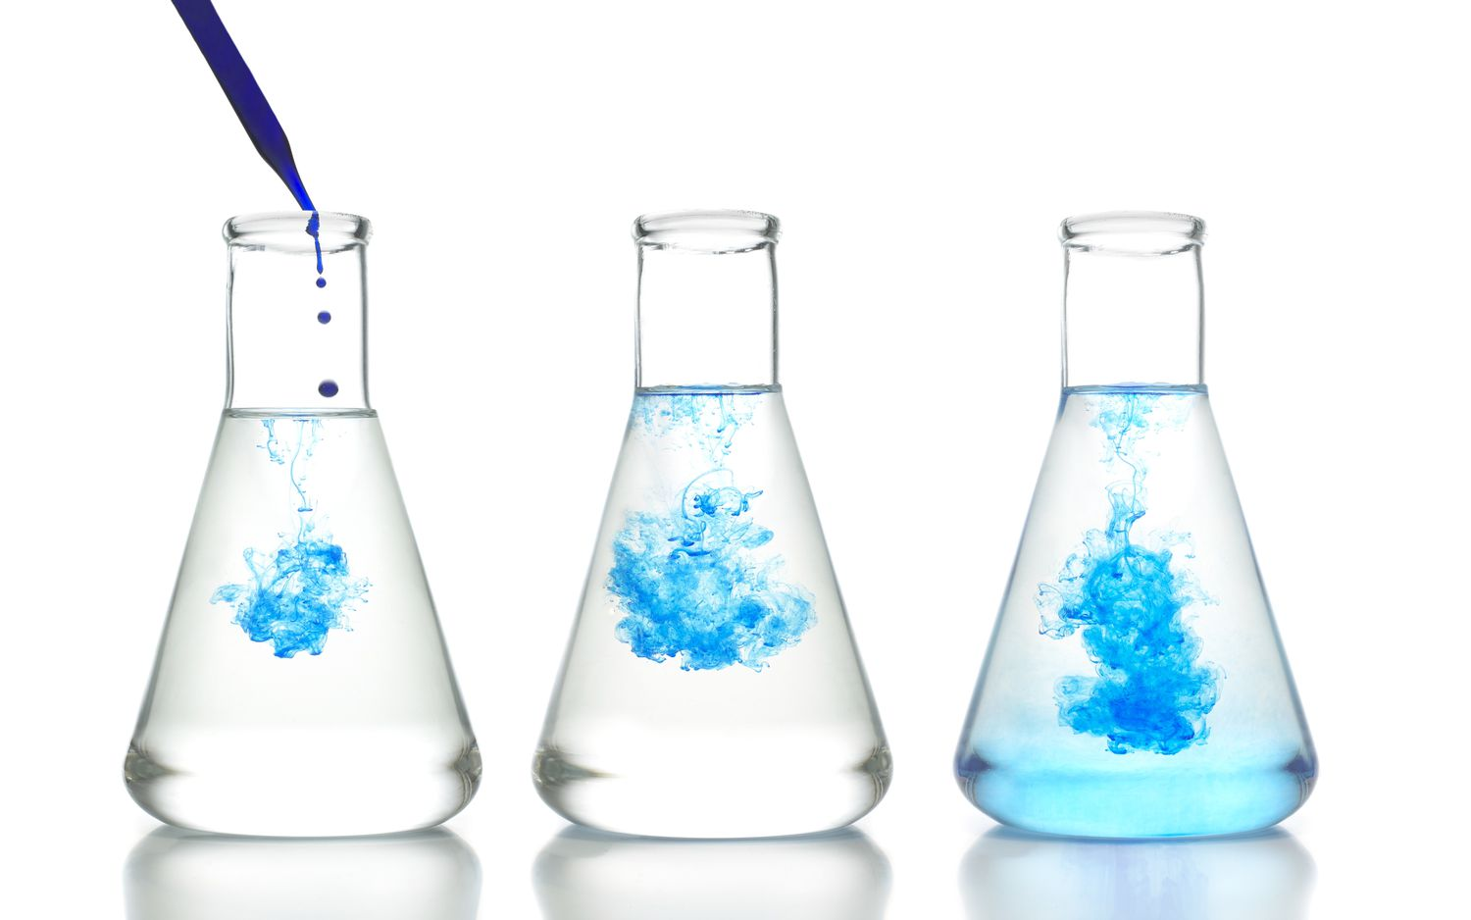
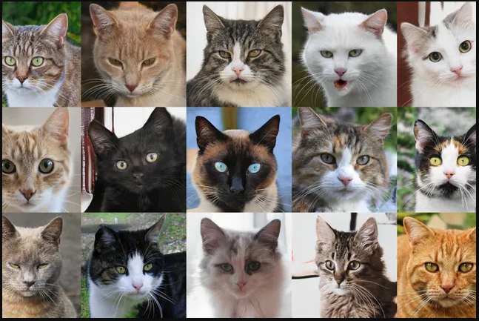

2. PROBLEM DEFINITION
Data scarcity can be solved through Generative AI.
Text-to-image model enhances understanding and communication visually.
Idea can be represented quickly through the model without technical expertise.

Slide 4
3. OBJECTIVE
To transform textual descriptions into visually appealing images.
To ensure the generated images are coherent and contextually accurate.
To provide a user-friendly interface for users to input text and retrieve generated images.

Slide 5
4. RESEARCH METHODOLOGY
4.1. Literature Review
4.2. The Framework Of The Model
4.3. Algorithms / Methods / Theory

Slide 6
4.1. Literature Review
Denoising Diffusion Probabilistic Model
Proposed diffusion probabilistic models.
Discovered connection between diffusion probabilistic models and denoising score matching.

Slide 7
4.1. Literature Review
Taming Transformers for High-Resolution Image Synthesis
Demonstrated the combination of CNNs and transformers.
Produced highly synthesized images outperforming state-of-the-art convolutional approaches.

Slide 8
4.1. Literature Review
High-Resolution Image Synthesis with Latent Diffusion Models
Presented the concept of latent space using pre-trained autoencoders.
Introduced cross-attention conditioning for high resolution synthesis.

Slide 9
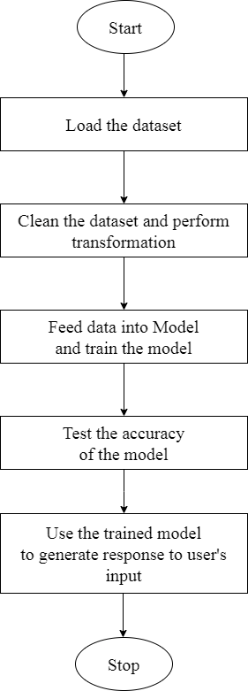
4.2. The Framework Of The Model
Fig: Framework of the Model

Slide 10
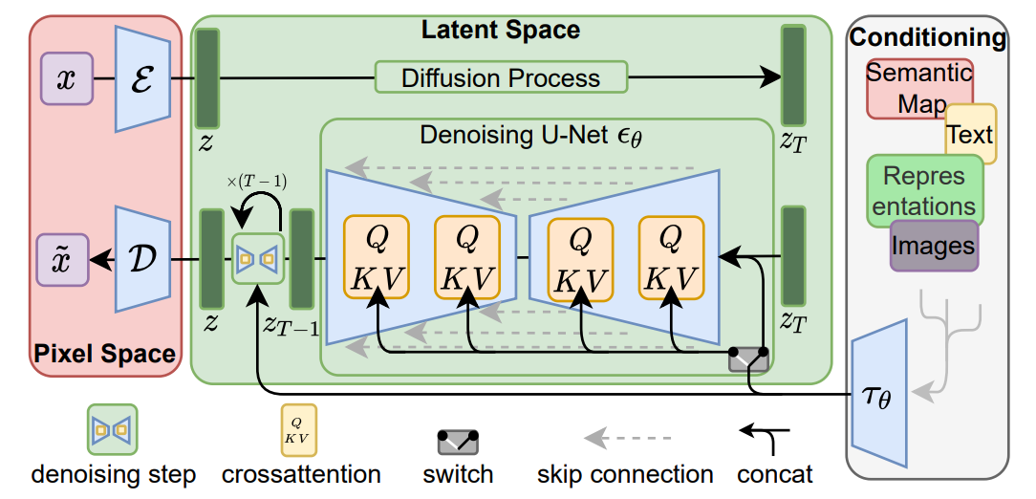
4.3. Algorithms / Methods / Theory
Fig: Architecture of the Model

Slide 11
Autoencoder
Gaussian Noise and Forward Diffusion
Denoising U-Net and Reverse Diffusion

Slide 12
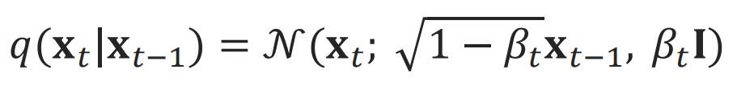
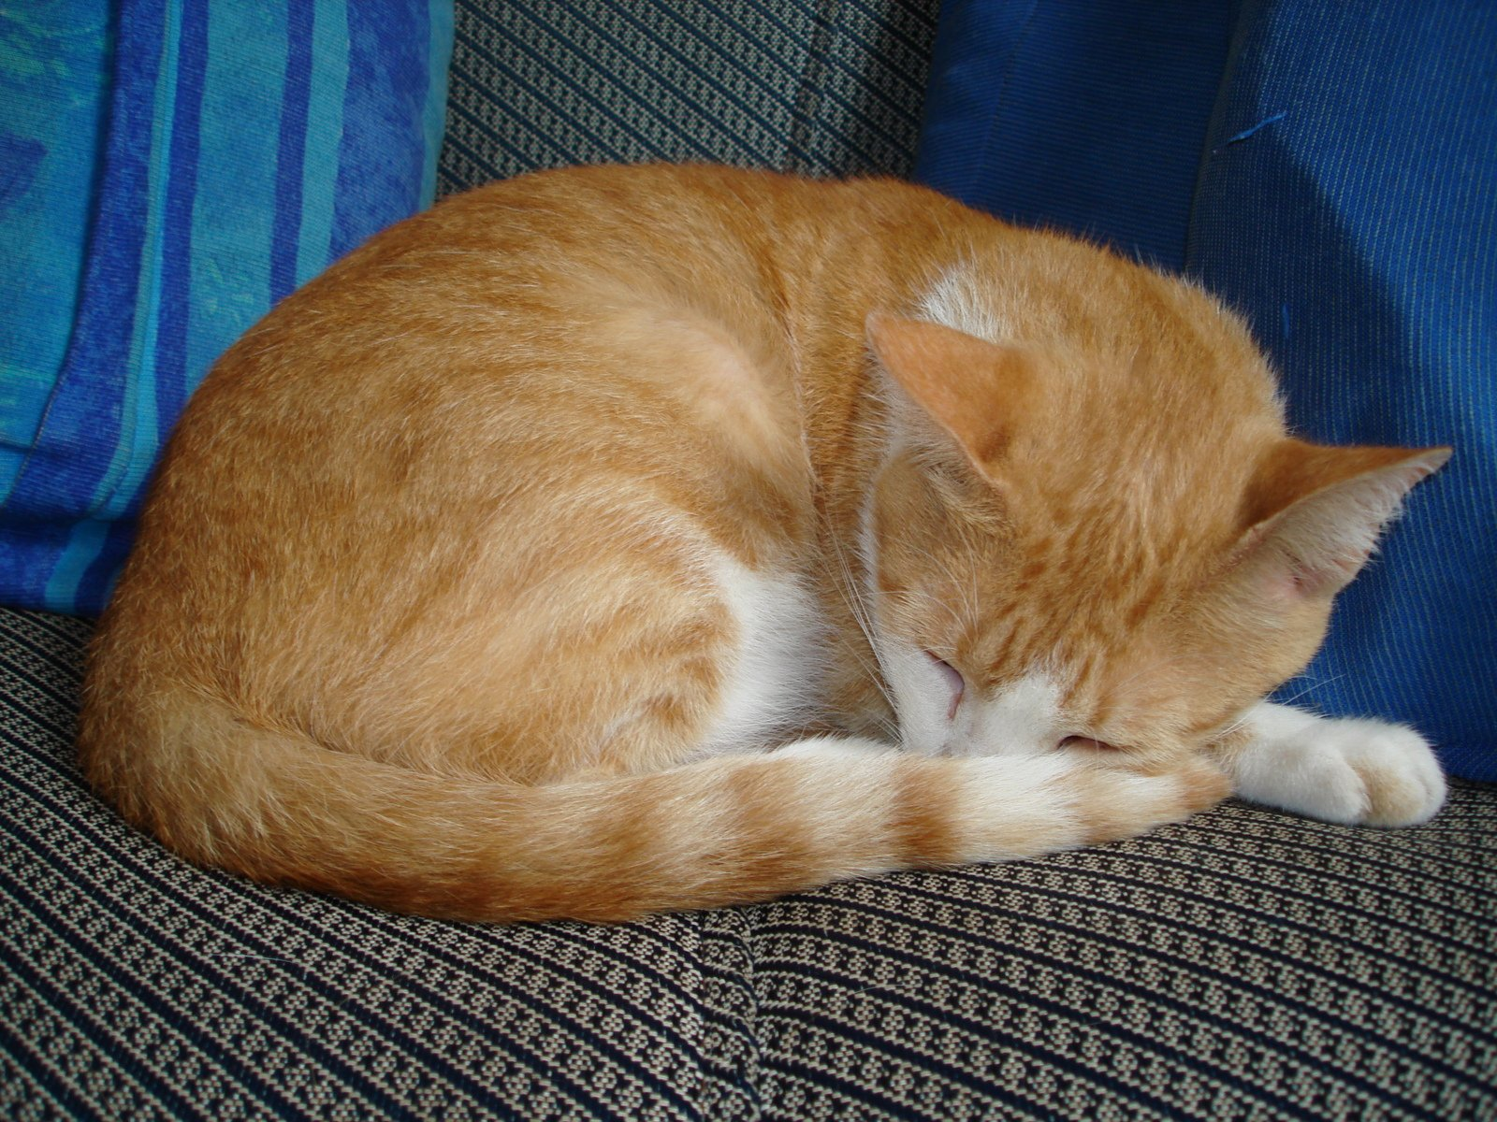
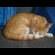
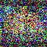
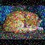
64 X 64
8 times less
Cat Sleeping
512 X 512
Mean
Variance
001
002
Cat = 001
Sleeping = 002

Slide 13
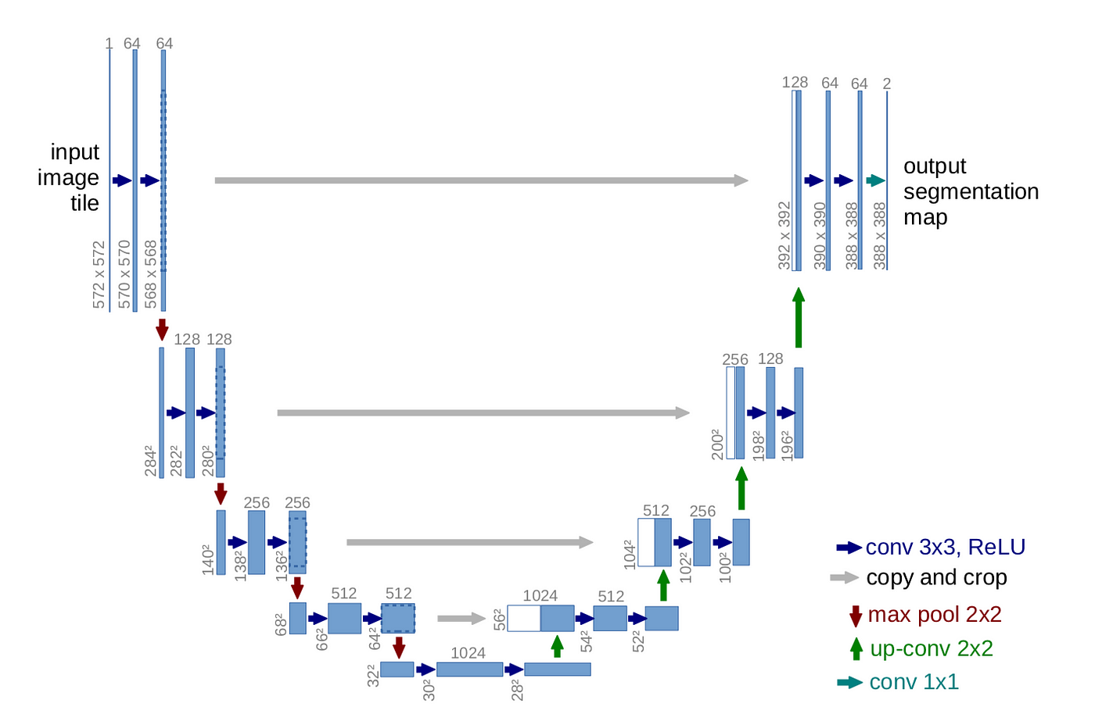
4.3. Algorithms / Methods / Theory
Fig: U-Net Architecture

Slide 14
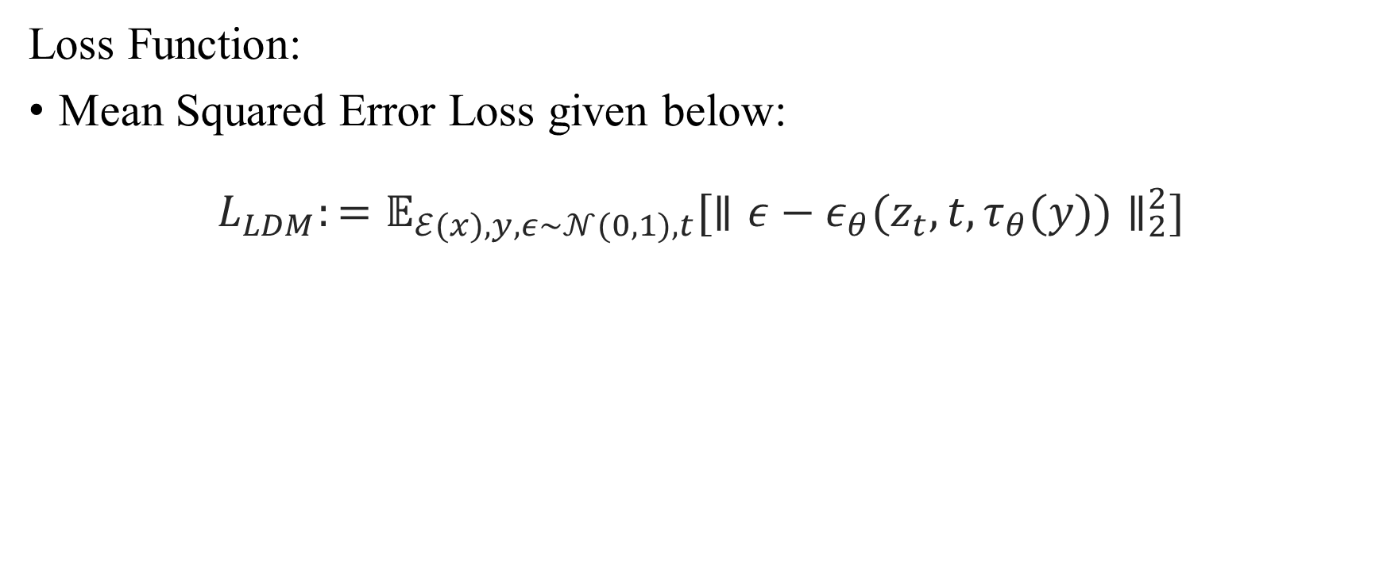
4.3. Algorithms / Methods / Theory
Loss Function:
Mean Squared Error Loss given below:
$$L_{LDM}:=𝔼_{ℰ(x),y,ε∼𝒩(0,1),t}[{∥ε−ε_{θ}(z_{t},t,τ_{θ}(y))∥}_{2}^{2}]$$

Slide 15
5. DATA COLLECTION
Online Dataset: Subsets of non-commercial datasets such as LAION, ImageNet image-text pairs datasets and various other datasets.
Web Scraping: Python web scraping scripts will crawl the web and look for image-text pairs.

Slide 16
6. TESTING AND VERIFICATION
Testing:
Unit Testing
Functional Testing
System Testing
Verification:
Perceptual Metrics
User Evaluation

Slide 17
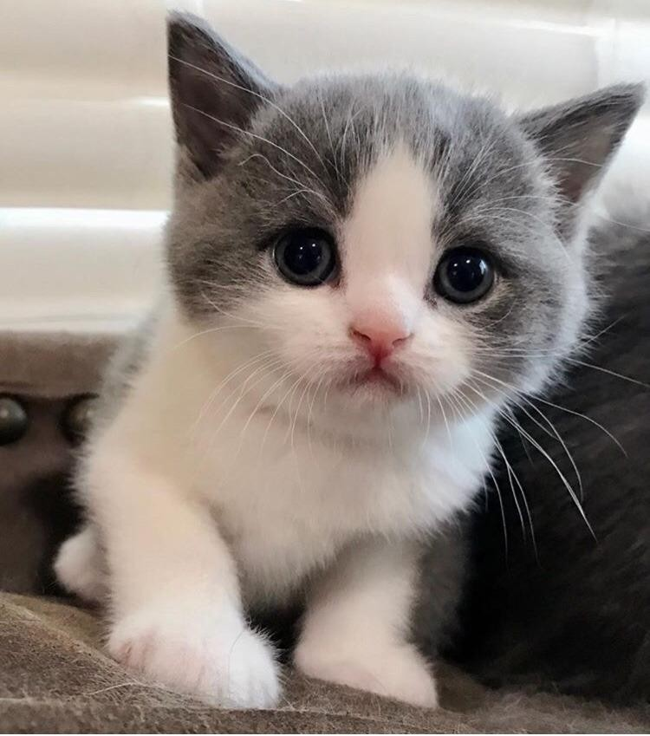
7. EXPECTED OUTPUT
Prompt: “Cat Sleeping”
Prompt: “Baby Cat”

Slide 18
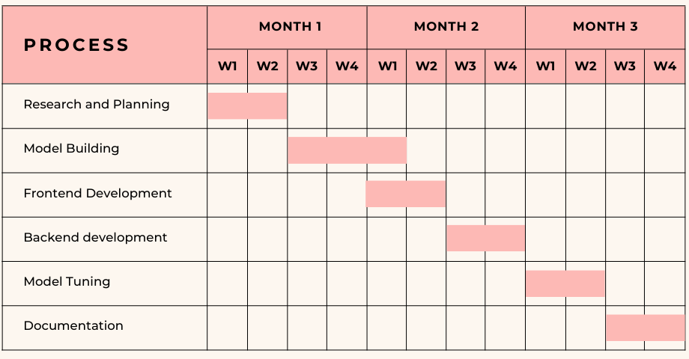
8. GANTT CHART
Fig: Gantt Chart of the Project

Slide 19
9. REFERENCES
[1] Robin Rombach, Andreas Blattmann, Dominik Lorenz, Patrick Esser, Bjorn Ommer, “High-Resolution Image Synthesis with Latent Diffusion Models”, Arxiv, Apr. 13, 2022. [Online]. Available: https://arxiv.org/pdf/2112.10752.pdf
[2] Patrick Esser, Robin Rombach, Bjorn Ommer, “Taming Transformers for High-Resolution Image Synthesis” Arxiv, Dec. 16, 2020. [Online]. Available: https://arxiv.org/pdf/2006.11239.pdf
[3] Jonathan Ho, Ajay Jain and Pieter Abbeel, “Denoising Diffusion Probabilistic Models”, Arxiv, Dec. 16, 2020. [Online]. Available: https://arxiv.org/pdf/2006.11239.pdf
[4] Olaf Ronneberger, Philipp Fischer and Thomas Brox, “U-Net: Convolutional Networks for Biomedical Image Segmentation”, Arxiv, May. 18, 2015. [Online]. Available: https://arxiv.org/pdf/1505.04597.pdf

